Slide 1

Loan Approval Analysis

Slide 2
Overview
Problem Statement
Objective
Motivation & Purpose
Scope & Significance
Challenges
Data Source
Methodology
Model Evaluation & Results
Conclusion

Slide 3
Problem Statement
In the financial sector, analyzing loan approval is pivotal for both applicants and lending institutions.
This project employs applicant data, encompassing variables such as loan amount, tenure, credit score, education, and assets, to scrutinize and understand the factors influencing the approval of a loan application by the bank.
The goal is to unravel key insights that shed light on the intricate dynamics of loan approval, offering valuable perspectives for stakeholders navigating the complexities of financial evaluations.

Slide 4
Objective
The primary objective is to develop a predictive model that can analyze applicant information and determine the likelihood of loan approval.
This model will not only offer valuable insights into the intricate factors steering loan approval decisions but also empower the bank to strategically prioritize services.
By focusing on customers with a higher probability of approval, the bank aims to enhance its operational efficiency and deliver tailored financial solutions that align with individual needs and preferences.

Slide 5
Motivation
In the banking sector, loan distribution is a core business function, constituting a significant portion of a bank's assets and profits.
While the current loan approval process involves thorough verification, there is a need to ensure the chosen applicant is the most deserving.
This project aims to predict applicant safety, automating the validation process through machine learning.
The motivation lies in enhancing the precision and efficiency of loan approval, aligning with the bank's commitment to secure and prudent investments.

Slide 6
Purpose
The purpose of our loan approval analysis is threefold: to enhance risk management, optimize operational efficiency, and foster a customer-centric approach.
By providing data-driven insights, the analysis is purposed to enable informed decision-making, ensure compliance, and contribute to financial inclusion.
The adaptive model serves a strategic purpose, navigating market dynamics for a competitive edge while aligning with ethical practices.
Ultimately, the overarching purpose is to drive innovation, improve financial sustainability, and advance responsible lending practices within the banking sector.

Slide 7
Scope and Significance
The scope of our loan approval analysis is comprehensive, encompassing the exploration of key features influencing loan approval decisions. This includes an in-depth examination of variables such as loan amount, tenure, credit score, education, and assets.
The analysis extends to risk assessment, model accuracy refinement, and the development of an adaptive predictive model through structured data preprocessing and feature engineering.
The analysis is significant for revolutionizing lending by enhancing risk management, operational efficiency, and customer-centric approaches.
It provides data-driven insights for informed decision-making, ensures compliance, and contributes to financial inclusion, driving innovation and responsible lending practices in the banking sector.

Slide 8
Challenges
Understanding the impact of intricate features like credit scores and assets on loan approval decisions.
Feature Complexity
Achieving precise risk assessment for informed decision-making in lending.
Risk Assessment Precision
Building a reliable predictive model with high accuracy for classifying loan approval status.
Model Accuracy
Ensuring interpretability of models for stakeholder trust and understanding.
Interpretability of Models

Slide 9
Data Quality and Preprocessing
Ensuring data quality by addressing issues like missing values and outliers during preprocessing.
Dynamic Market Conditions
Navigating the impact of dynamic market conditions on the relevance and accuracy of predictive models..
Meeting stringent regulatory standards to ensure compliance with legal and ethical guidelines.
Regulatory Compliance
Technological Integration
Seamlessly integrating emerging technologies into the analysis process without introducing complexities

Slide 10

What is Loan Approval ?
Loan approval is the evaluation process conducted by a lending institution to decide whether to grant or deny a borrower's loan application.
It involves assessing the borrower's creditworthiness, financial stability, and ability to repay.
Approval results in a formal agreement specifying the loan terms.

Slide 11
Loan Approval Process
The loan approval process involves the following key steps:
1
Application Submission
8
2
Loan Agreement
Credit Check
Loan Approval Process
7
3
Decision Making
Income Verification
6
4
Appraisal and Documentation
Debt-to-Income Ratio Analysis
5
Collateral Evaluation

Slide 12

Data Source
I utilize Kaggle datasets in my examination of loan approval dynamics.
These datasets, contributed by various sources and challenges, contain essential information such as credit scoring details, historical loan performance data, and demographic indicators.
Leveraging these Kaggle datasets allows me to access curated and real-world information, enriching the depth and relevance of my analysis within the loan approval domain.
https://www.kaggle.com/datasets/architsharma01/loan-approval-prediction-dataset

Slide 13
Dataset Specifications
Variable | Description | DataType
loan_id | Unique identifier for each loan | Number
no_of_dependents | Number of dependents of the applicant | Number
education | Education level of the applicant | String
self_employed | Whether the applicant is self-employed or not | String
income_annum | Annual income of the applicant | Number
loan_amount | Loan amount requested by the applicant | Number
loan_tenure | Tenure of the loan requested by the applicant (in Years) | Number
cibil_score | CIBIL score of the applicant | Number
residential_asset_value | Value of the residential asset of the applicant | Number
commercial_asset_value | Value of the commercial asset of the applicant | Number
luxury_asset_value | Value of the luxury asset of the applicant | Number
bank_assets_value | Value of the bank asset of the applicant | Number
loan_status | Status of the loan (Approved/Rejected) | String

Slide 14
Methodology
Data Collection
Data Preprocessing
Exploratory Data Analysis(EDA)
Feature Engineering
Machine Learning Algorithms
Model Evaluation
Results

Slide 15
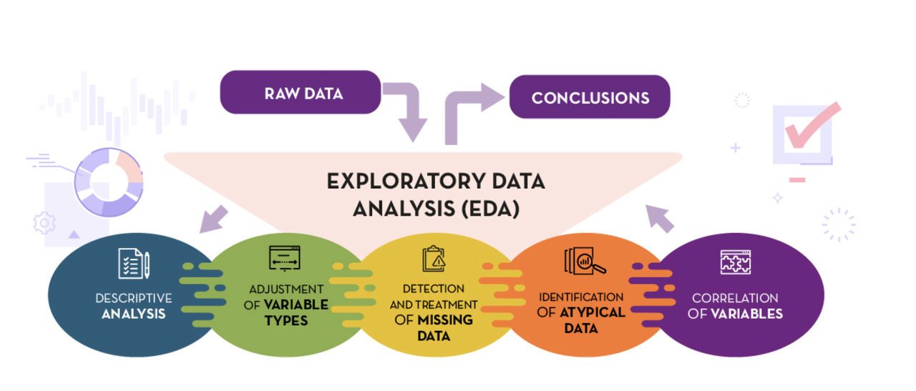
Exploratory Data Analysis (EDA)
Exploratory Data Analysis (EDA) is our project's initial phase, aiming to understand the dataset's key characteristics.
Through descriptive stats, visualizations, and targeted analyses, we reveal patterns, assess correlations, and gain insights into loan approval status.
This EDA informs subsequent preprocessing and modeling decisions, ensuring a nuanced approach to our data analysis.

Slide 16
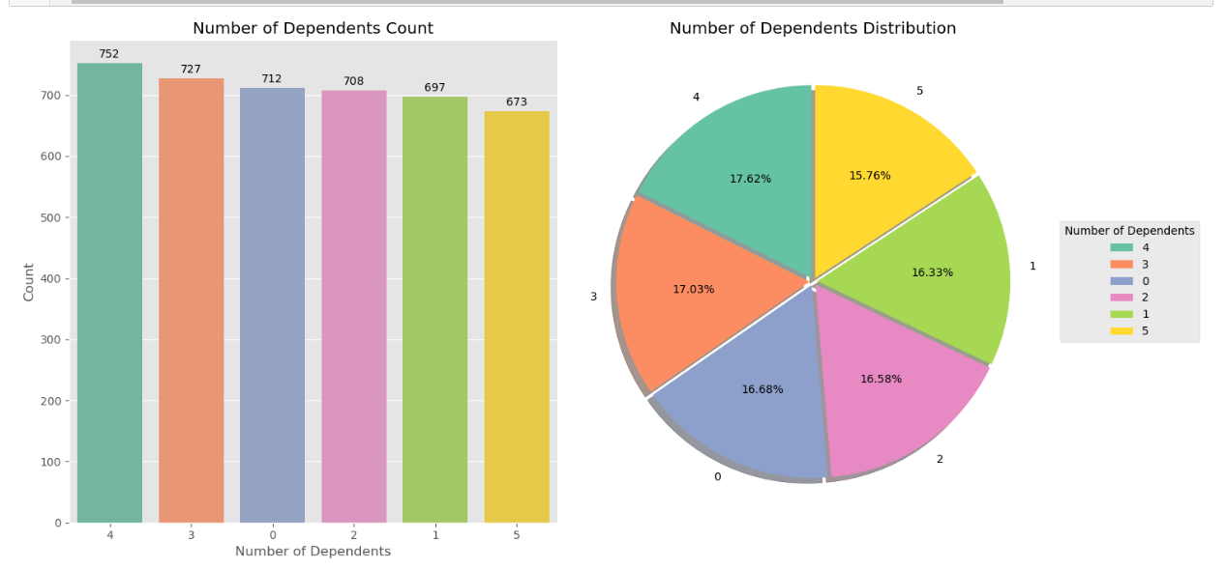
Number of Dependents
Interpretation:
The graph indicates a consistent distribution of dependents among loan applicants, with a notable concentration in the 4 and 3 dependent categories. As dependents increase, disposable income decreases. I infer that applicants with 0 or 1 dependent have a higher chance of loan approval, suggesting a favorable financial situation for eligibility.

Slide 17
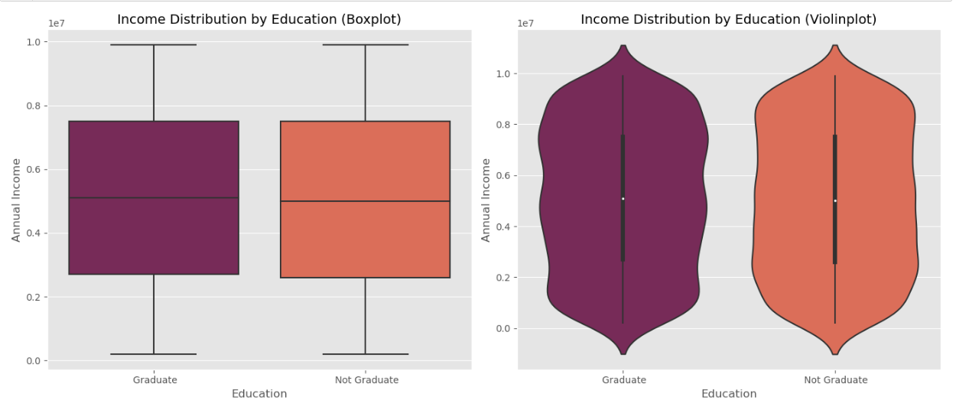
Education & Income
Interpretation:
Boxplot and violinplot comparisons of graduate and non-graduate applicants' incomes suggest minimal differences. Non-graduates display a more even income distribution, while graduates concentrate in the 6,000,000 to 8,000,000 range. Limited disparity indicates education may not strongly influence the loan approval process.

Slide 18
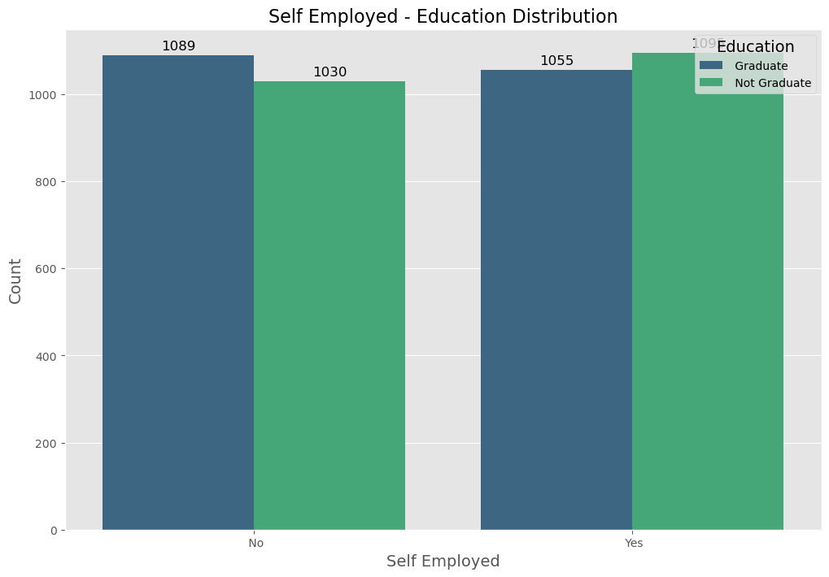
Employment Status & Education
Interpretation:
This visualization indicates that graduates favor non-self-employment, while a significant portion of non-graduates opts for self-employment. This difference could influence loan approval, with salaried roles typically offering more stable income, but self-employed applicants may have higher incomes.

Slide 19
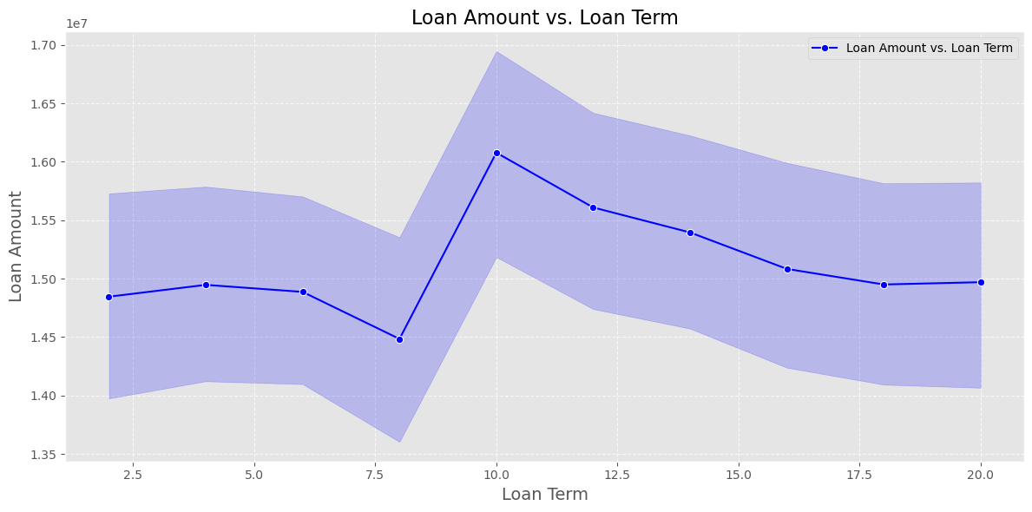
Loan Amount & Tenure
Interpretation:
This line plot reveals a consistent loan amount (1,400,000 to 1,550,000) for tenures between 2.5 and 7.5 years. A notable deviation occurs for a 10-year tenure, indicating a substantial increase in loan amount.

Slide 20
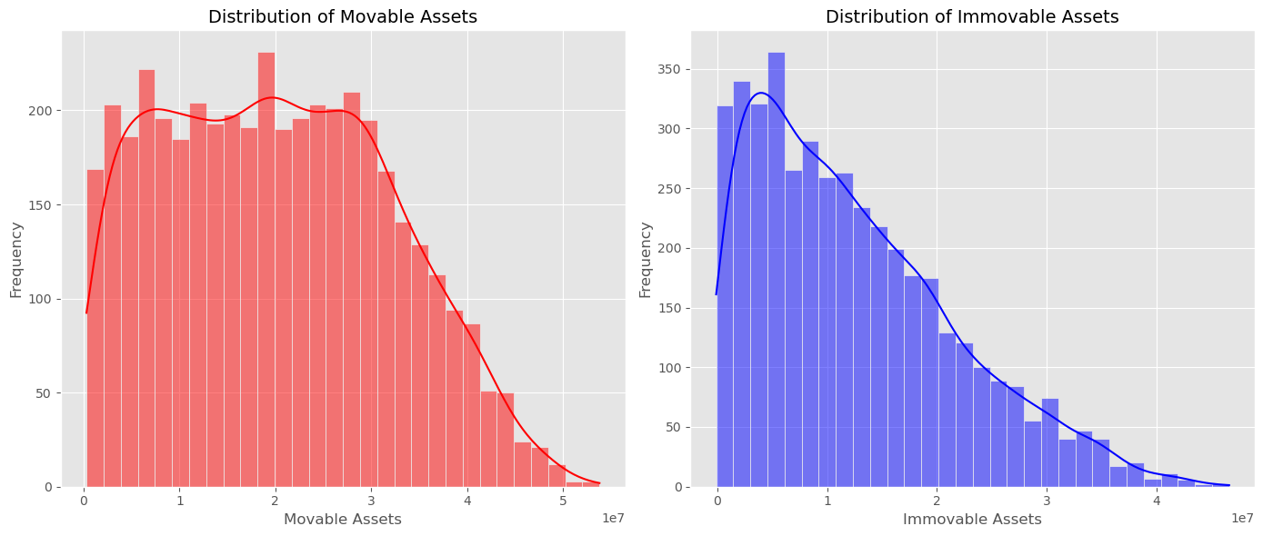
Assets Distribution
Interpretation:
Movable assets (bank and luxury) trend below 30 million, with fewer applicants as values rise. Immovable assets (residential and commercial) follow a similar pattern, predominantly below 15 million, decreasing significantly as values exceed 20 million.

Slide 21
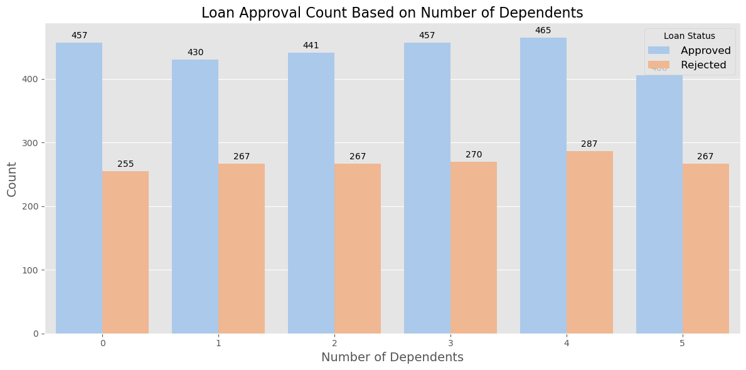
Number of Dependents Vs Loan Status
Interpretation:
Mixed results emerge for the hypothesis on loan approval and dependents. Rejected loans increase with more dependents, but approved loans show no significant change. The observed data patterns challenge the initial assumptions, indicating a nuanced relationship.

Slide 22
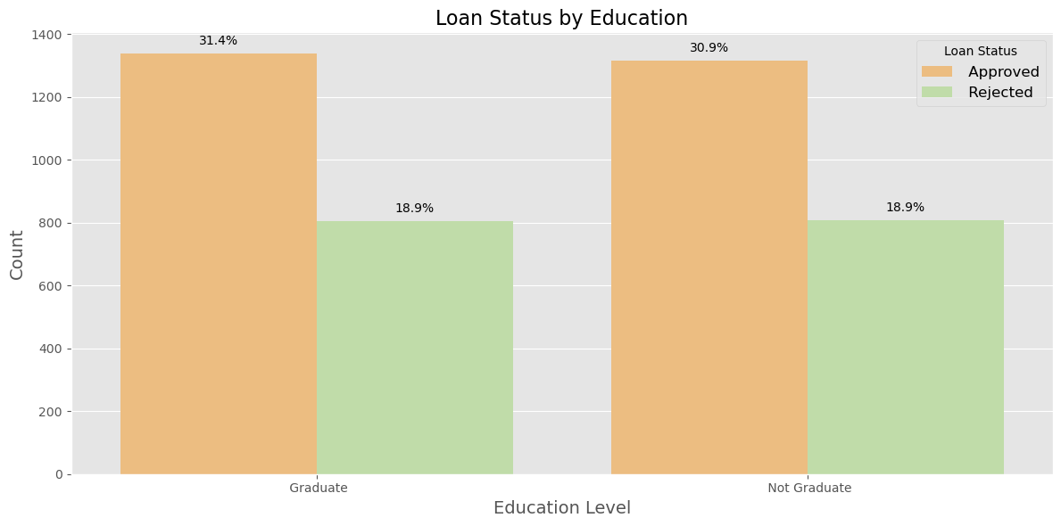
Education Vs Loan Status
Interpretation:
The observed data supports the hypothesis that education is not a decisive factor in loan approval. The graph indicates only a marginal difference in approvals and rejections between graduate and non-graduate applicants, suggesting education plays a limited role in the process.

Slide 23
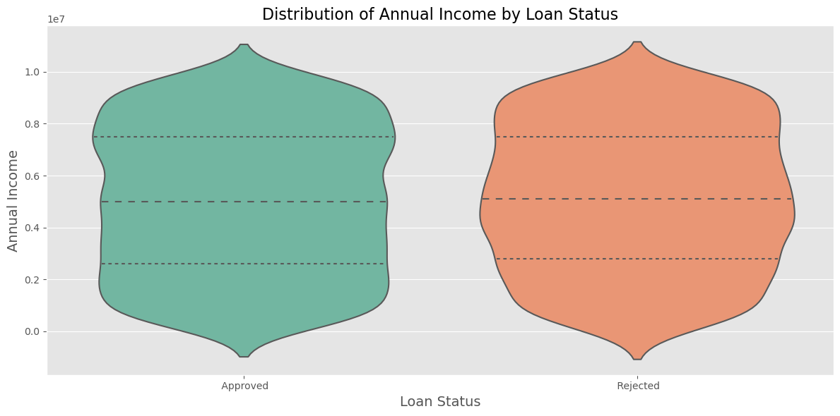
Annual Income Vs Loan Status
Interpretation:
In the overall analysis, no significant income disparity is observed between approved and rejected loan applicants. However, a discernible trend indicates that approved applicants generally have higher annual incomes, particularly evident in the violin plot with a higher density around 8 million

Slide 24
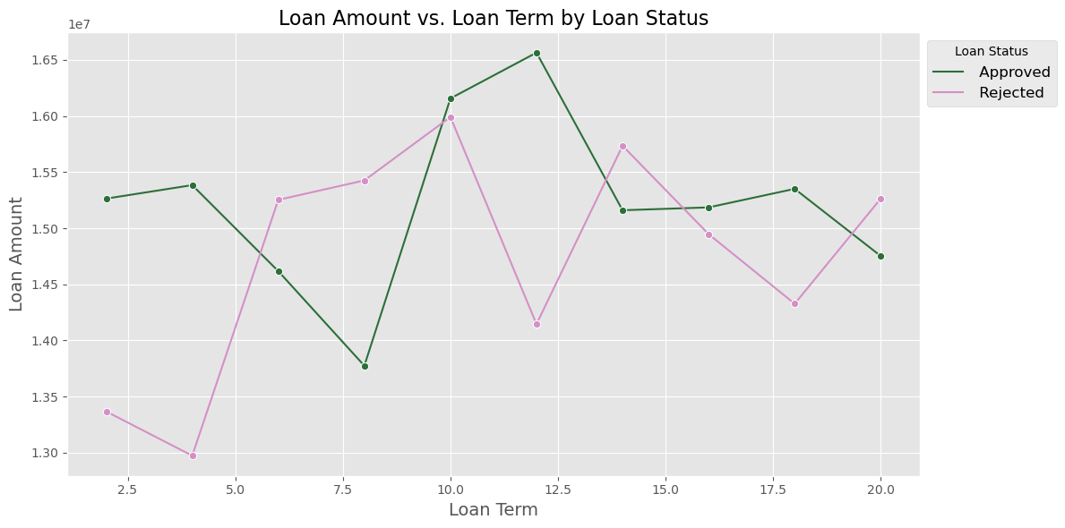
Loan Amount & Tenure Vs Loan Status
Interpretation:
The visualization reveals that approved loans typically have higher amounts with shorter tenures, while rejected loans exhibit lower amounts and extended tenures. This suggests a bank policy favoring shorter repayments for approved loans and a inclination to reject lower-amount loans, potentially for profitability.

Slide 25
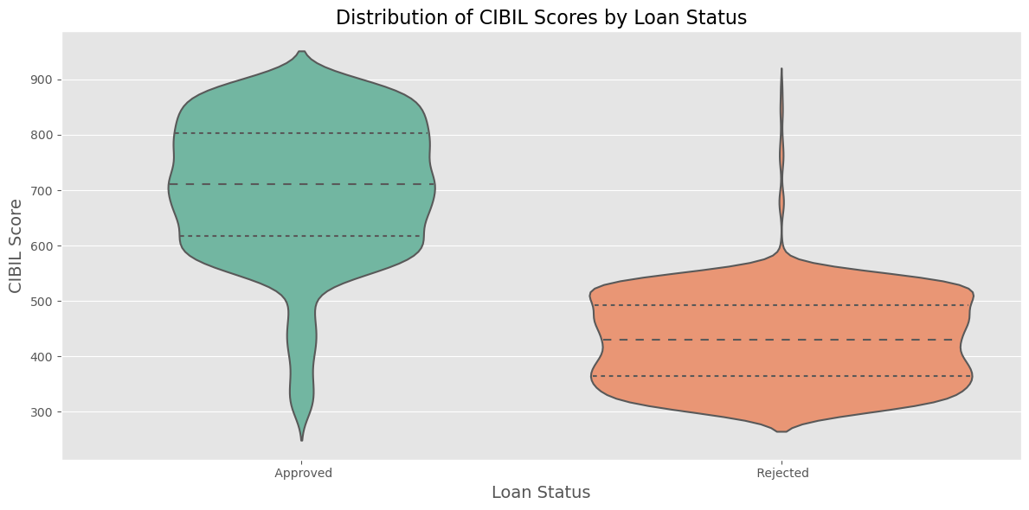
CIBIL Score Vs Loan Status
Interpretation:
The observed patterns in the violin plot undeniably confirm the hypothesis on the relationship between CIBIL scores and loan approval. Scores above 600 are prominently distributed in approved loans, contrasting with a dispersed distribution below 550 in not-approved loans. This establishes a clear association, indicating that a CIBIL score exceeding 600 is a key factor linked to higher chances of loan approval.

Slide 26
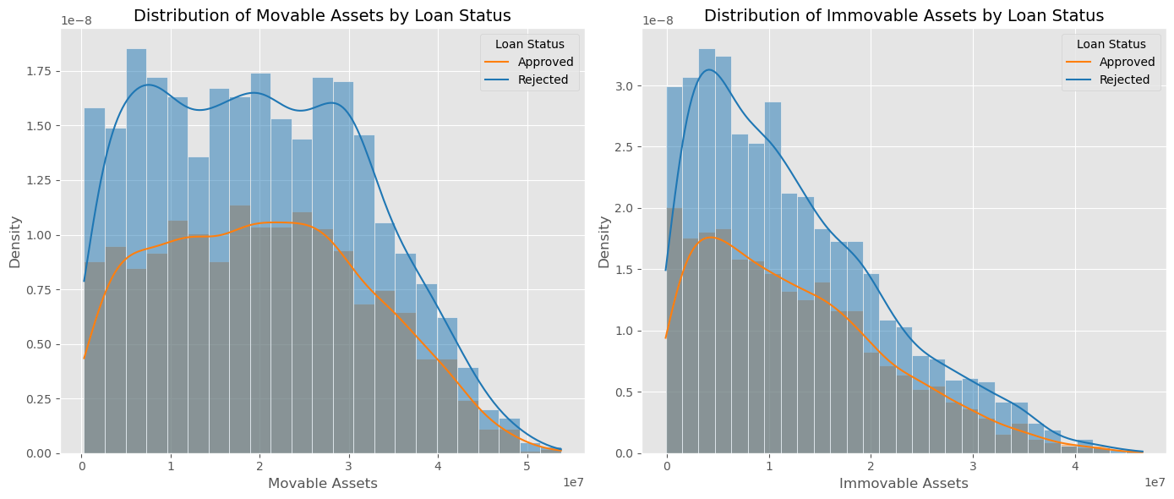
Assets Vs Loan Status
Interpretation:
Assets, providing security, correlate with loan status in the visualizations. As assets increase, there's a higher likelihood of approval and reduced chances of rejection. Notably, the graphs emphasize a trend where the quantity of movable assets surpasses that of immovable assets.

Slide 27
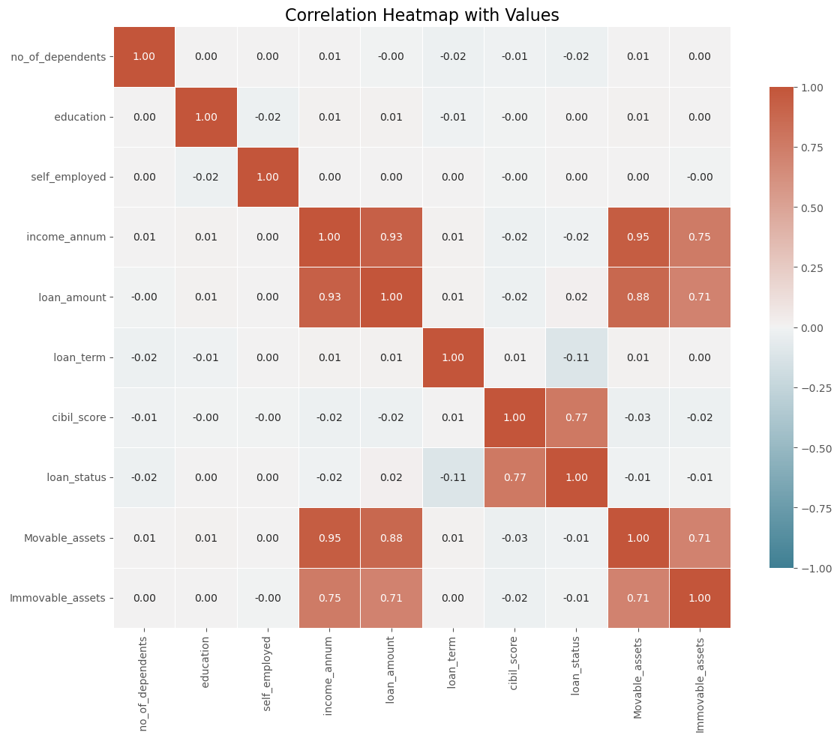
Correlation Matrix Heatmap
The heatmap highlights strong correlations, including between movable and immovable assets, income and assets, and assets and loan amount. This logical relationship suggests individuals with higher movable assets likely possess more immovable assets. Positive correlations with income align with expectations. Further exploration into asset-loan and income-loan relationships will provide additional insights.

Slide 28
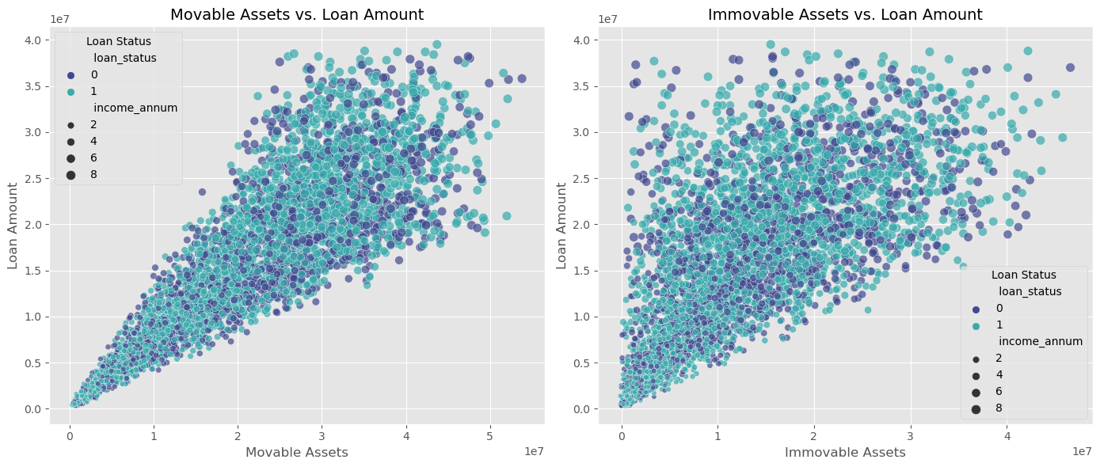
Assets Vs Loan Amount
Interpretation:
The loan amount has a positive relation with movable and immovable assets. The more the assets, the more the loan amount issued by the bank.

Slide 29
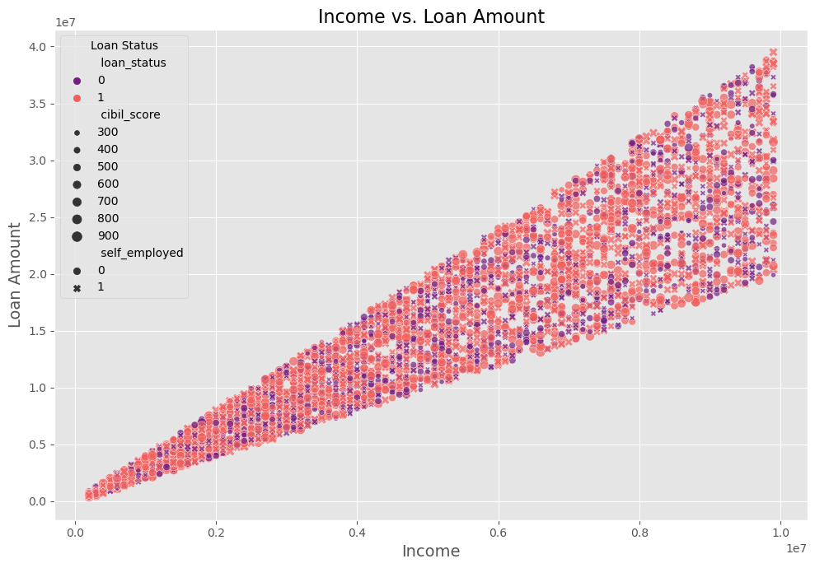
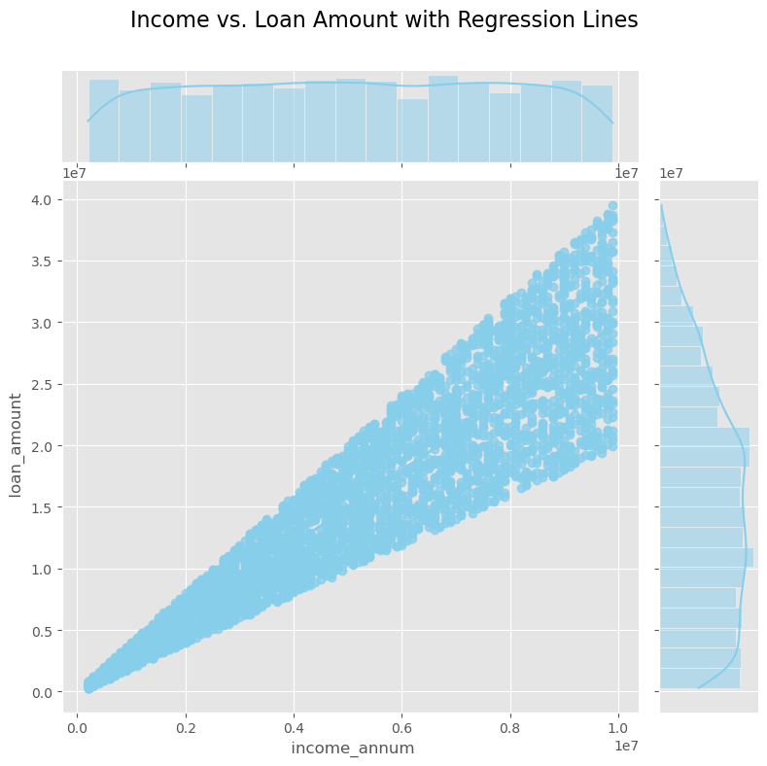
Loan Amount Vs Income
Interpretation:
There exists a strong correlation between the loan amount and the annual income of the applicant. As the applicant's income increases, the loan amount also tends to increase. This correlation is directly proportional, indicating that the applicant's income plays a pivotal role in determining the required loan amount.

Slide 30
Machine Learning Algorithms
Logistics Regression:
Logistic Regression is a binary classification algorithm used to predict the probability of an instance belonging to a specific class.
It's efficient, interpretable, and commonly applied in scenarios with two categorical outcomes, such as loan approval or rejection.
Support Vector Machine Classifier(SVC):
Support Vector Machine (SVM) is a powerful machine learning algorithm used for both classification and regression tasks.
It works by finding the hyperplane that best separates different classes in the feature space, maximizing the margin between them.

Slide 31
Machine Learning Algorithms
Decision Tree Classifier:
Decision Tree is a tree-like model where each node represents a feature, each branch a decision, and each leaf an outcome.
It's widely used for classification tasks, providing a clear, interpretable decision-making structure.
Random Forest Classifier:
Random Forest is an ensemble learning method that constructs multiple decision trees during training and outputs the mode of the classes as the prediction.
It improves accuracy and robustness by combining predictions from multiple trees.

Slide 32
Machine Learning Algorithms
Naïve Bayes Classifier:
Naïve Bayes is a probabilistic classification algorithm based on Bayes' theorem.
It assumes independence between features, and despite its simplicity, it often performs well in various applications, such as text classification and spam filtering.
KNN Classifier:
K-Nearest Neighbors (KNN) is a simple and intuitive classification algorithm.
It classifies a data point based on the majority class among its k nearest neighbors. It's effective in scenarios where the decision boundaries are not well-defined.

Slide 33
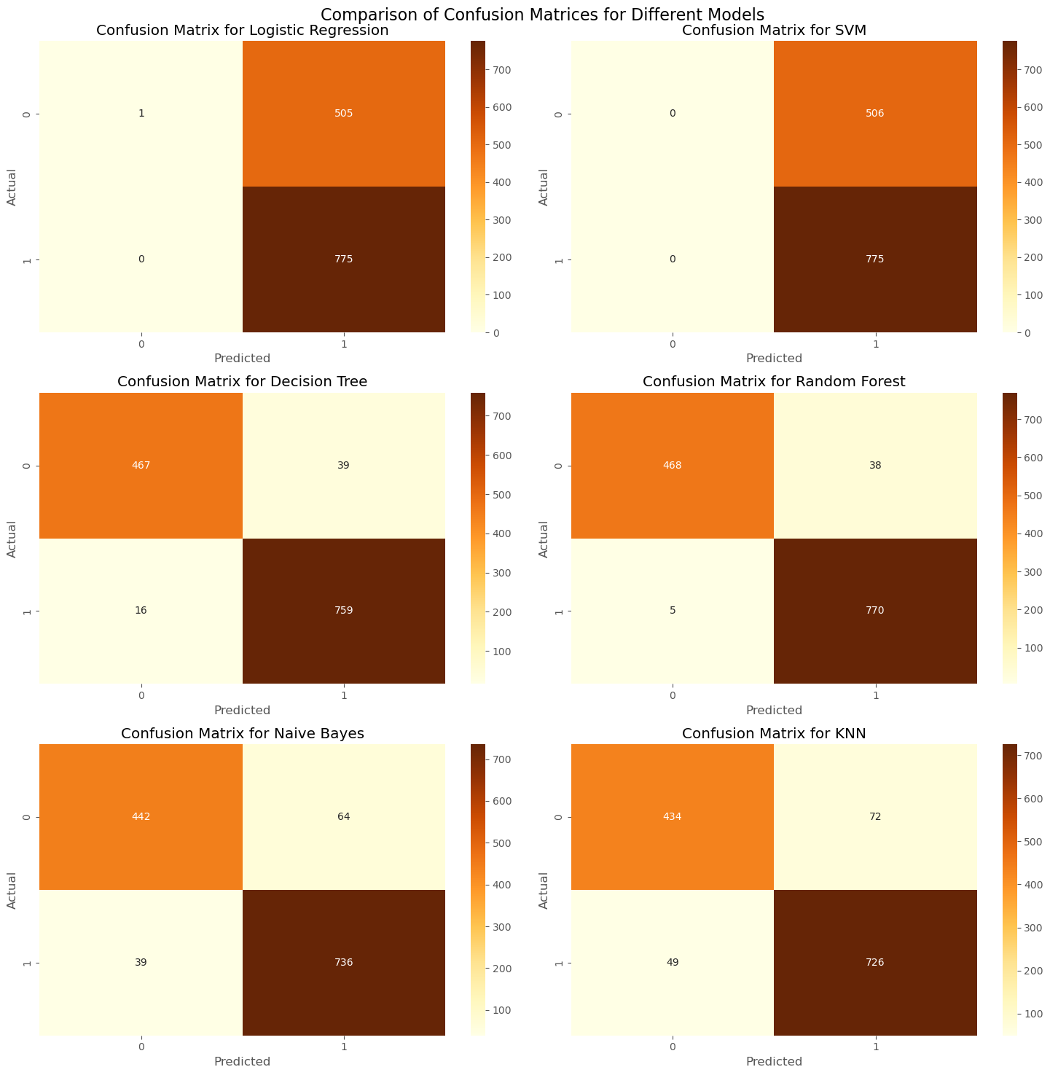
Model Evaluation Confusion Matrix

Slide 34
Interpretation:
The heatmap reveals distribution of true positives and true negatives in different ML models. Logistic regression and support vector classifiers show 505 combined false positives and false negatives. In contrast, decision tree and random forest classifiers exhibit superior performance with only 49 occurrences. Naive Bayes shows 103 instances, and KNN demonstrates 121. Accuracy-wise, decision tree and random forest classifiers outperform other models.

Slide 35
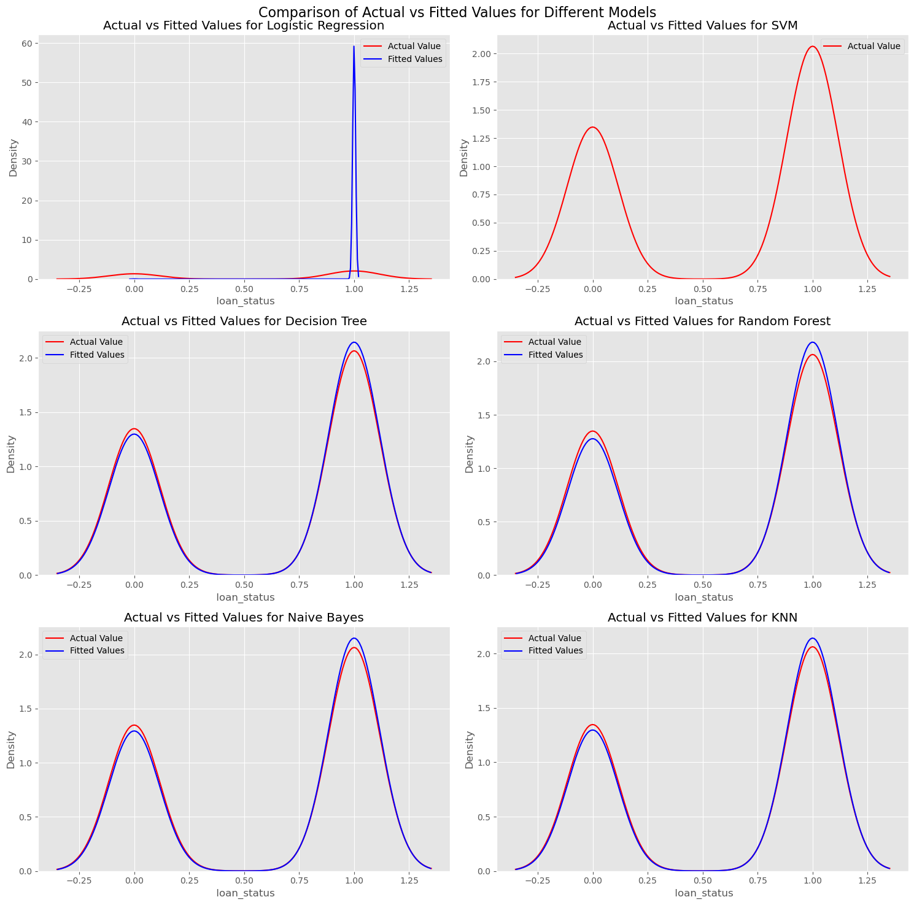
Distribution Plot

Slide 36
Interpretation:
The distribution plots for all models reveal comparable patterns, indicating similar distributions of predicted and actual values across different machine learning models. However, distinct differences are observed in the distribution density for Logistic Regression and SVM compared to the other models. These variations suggest unique characteristics in the prediction patterns of these two models.

Slide 37
Conclusion
Through the exploratory data analysis, several key factors have been identified as significant contributors to the loan approval process:
Decision Tree and Random Forest Classifiers achieve superior performance with 96% accuracy, leveraging their transparent structure and ensemble approach.
Logistic Regression, SVM, Naive Bayes, and KNN exhibit accuracies between 60% and 92%, indicating potential limitations.
CIBIL Score: Higher scores correlate with a greater likelihood of loan approval.
Number of Dependents: More dependents suggest a decreased likelihood of approval.
Assets: Higher ownership of movable and immovable assets increases the chance of approval.
Loan Amount and Tenure: Higher amounts with shorter tenures correlate with increased approval chances.

Slide 38
THANK YOU!

